Slide 1
SW tool & process
TadoSoft
Jacky
2011, May, 24

Slide 2
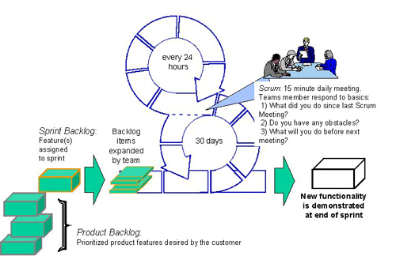
Scrum

Slide 3
Scrum (cont.)
IceScrum tool is used to track scrum activities
Currently we use two-week sprint
Bi-weekly Wed is review & retrospective day, and Thu is planning day

Slide 4
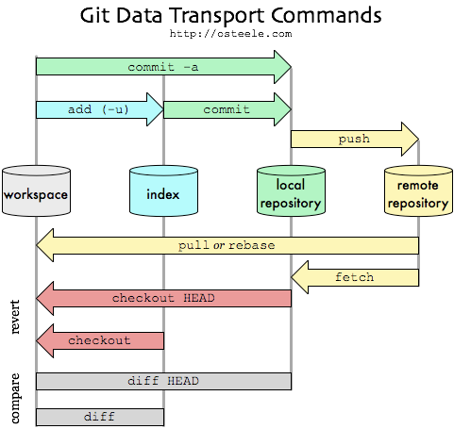
GIT for source control

Slide 5
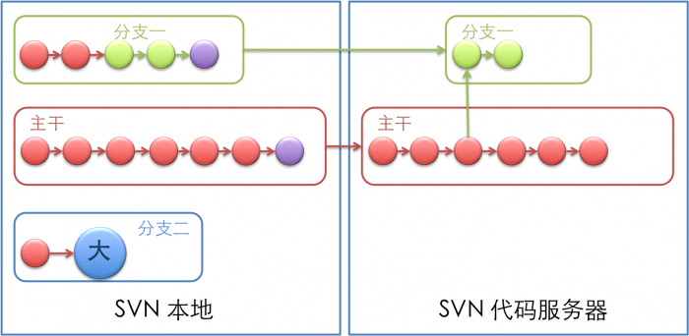
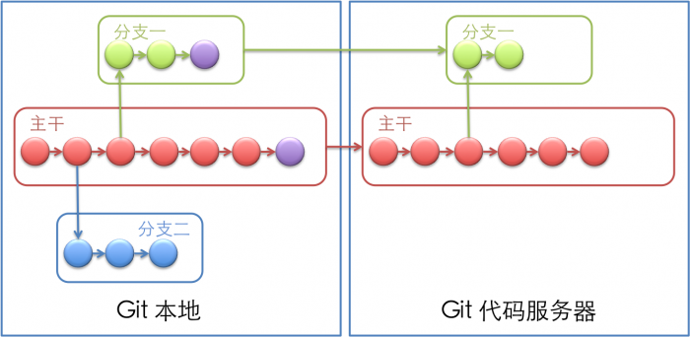
GIT compare to SVN

Slide 6
GIT Commands
git clone ssh://mebusw@192.168.9.88/var/krowd
git add main.c
git commit –m “…”
git push origin master
git status
git branch
git diff HEAD HEAD^
git remote add origin git@gitorious.org:var/abc.git
git config --global color.diff auto
git config --global alias.st status
git rebase origin

Slide 7
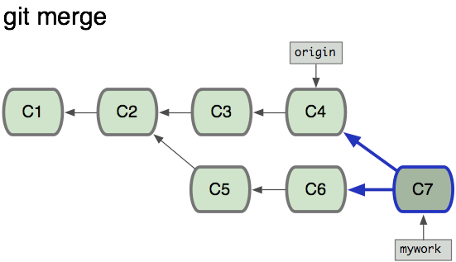
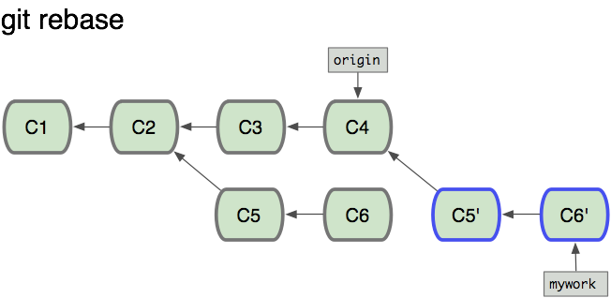
GIT Merge&Rebase

Slide 8
Doxygen for code document
It can translate comments in source code to document. (user java style comments)
How to use it in terminal: Just add doxygen path into ~/.bash_profile
E.g
export CLICOLOR=1
export LSCOLORS=ExFxCxDxBxegedabagacad
export PATH=/Applications/Doxygen.app/Contents/Resources/:$PATH

Slide 9
Java Style Comments for Doxygen
/**
* This function to open a file dialog.
* @param[in] filename Name of file.
* @return the file stream or null
* @author jacky
* @see FileStream
*/
FileStream fileDialog(String filename) {
int count; /** file count */
…
}

Slide 10
DIA for drawing charts
A freeware can be run on Win/Mac/Linux, to draw UML graph/ Flow Chart etc

Slide 11
Unit Test Coverage
Target is 100% coverage by Gcov
How to use in general:
Add flag of gcc compiler: gcc -fprofile-arcs -ftest-coverage main.c -o myapp
Run the execuable file: ./myapp
Check the coverage: gcov main.c

Slide 12
Unit Test Coverage in XCode
In unit test target:
Enable “Generate Test Coverage Files”
Enable “Instrument Program Flow”
Add “-lgcov” to “other linker flags”

Slide 13
Warnings
Warning means potential bugs
No warnings allowed for all code lines
Tools: gcc for obj-c, and javac for Java

Slide 14
Cyclomatic Complexity
The cyclomatic complexity of a section of source code is the count of the number of linearly independent paths through the source code.
Less than 15 for each function
Tools: hfcca (http://code.google.com/p/headerfile-free-cyclomatic-complexity-analyzer/downloads/detail?name=hfcca.py&can=2&q=) for obj-c
Tools: cyvis for java

